Slide 1
Ni-kshay Reports

Slide 2
Agenda
Various reports currently available in Ni-kshay
Number of Reports available in Ni-kshay
Ni-kshay Report - Dashboard
Definition of Reports

Slide 3
Reports Available in Ni-kshay

Slide 4

Reports available in Ni-kshay
Summary Reports (Patient management)
Patient-wise lists
Summary Reports (DBT)

Slide 5
Number of Reports available in Ni-kshay

Slide 6
Number of Reports available in Ni-kshay
Serial | Types of Reports | Number of Reports
1. | Summary Reports (Patient management) | 21
2. | DBT Reports – Summary & Line List Reports | 9
2a | Summary Reports (DBT) | 6
2b | Line List Reports (DBT) | 3
3. | Patient-wise lists | 30
4. | Patient Management | 5
Total Reports |  | 74

Slide 7
Ni-kshay Reports: Dashboard

Slide 8
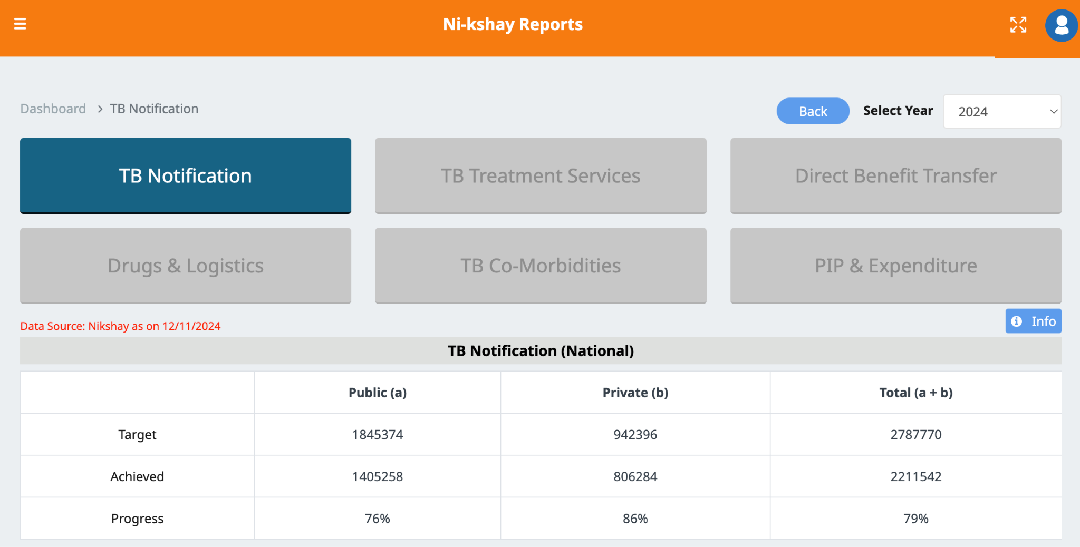
Nikshay Reports - Dashboard
Nikshay dashboard

Slide 9
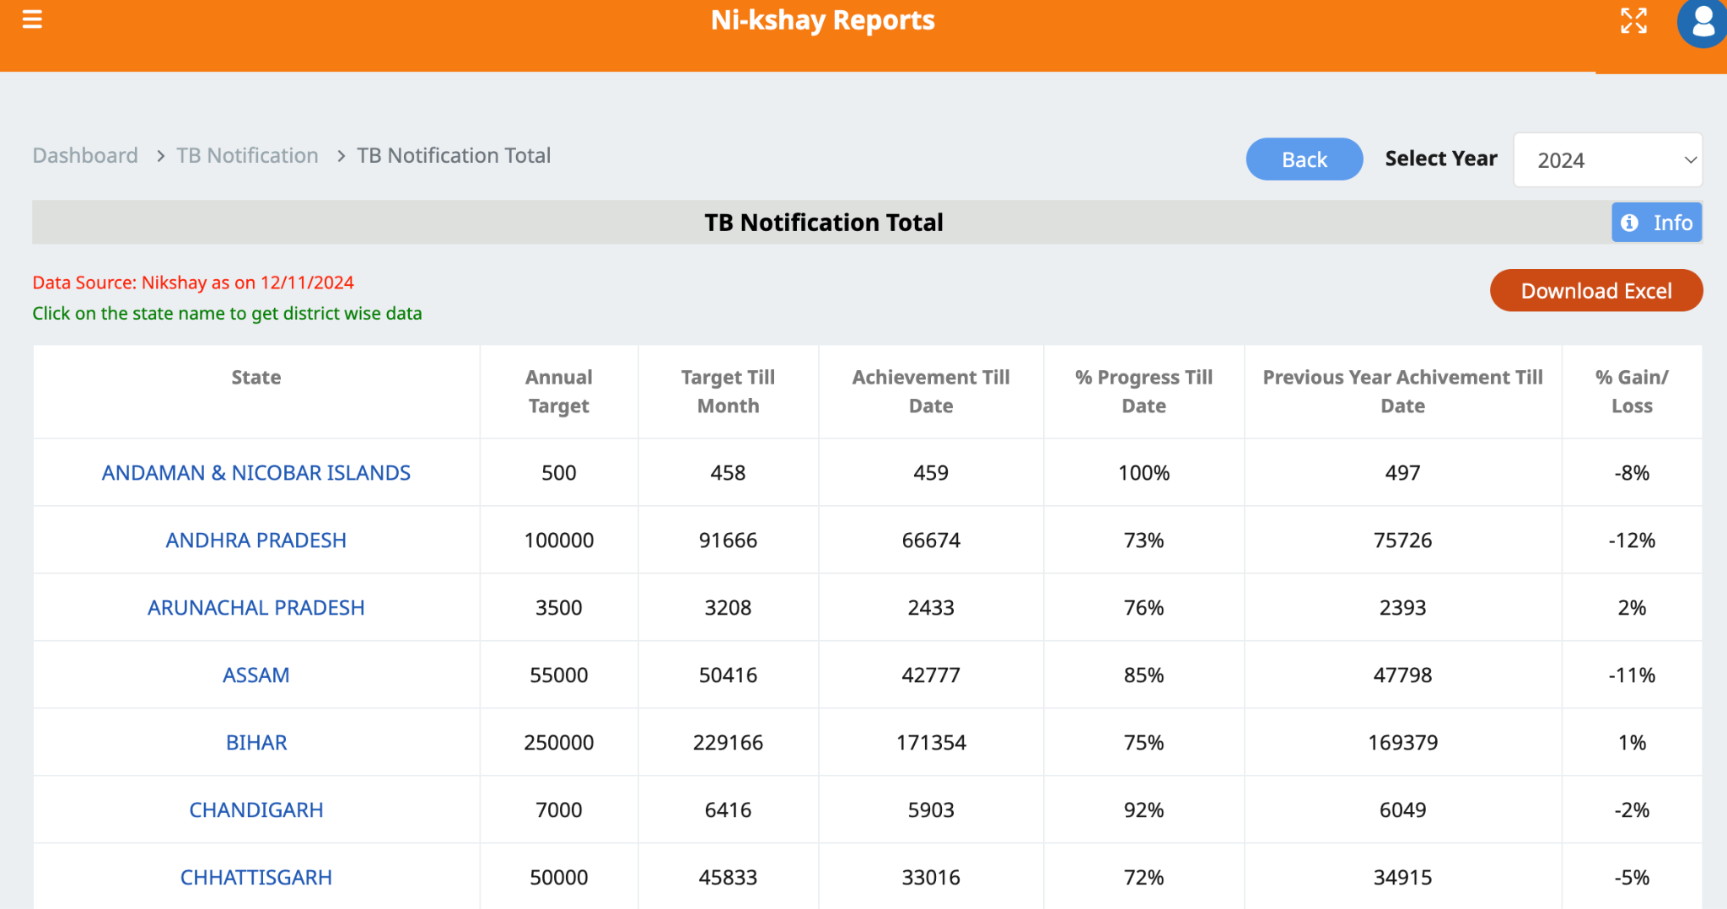
Nikshay Reports - Dashboard
Tracks Actual
v/s Target Logic Purpose

Slide 10
Definition of Reports

Slide 11
Summary Reports (Patient management)
Serial | Summary Reports | Description
1. | TB Notification | This report gives a graphical summary of state, district and TU-wise number of total notified TB cases from both Public & Private sector. This report enables the user to view at a glance the total number of TB Patients notified based on date range (spectrum Date of diagnosis) selected by user. These counts are based on the “Enrolment and Diagnosing facility” of the patients.
2 | ACF Excel Export | This excel export provides information on the “Active Case Finding” module in a given month based on the date of activity. This register has 15 number of fields which provides details on ACF related to following: ACF Mapping ID and ACF Mapping name Total and Target population Date of mapping and date of activity Number of cases screened for symptoms, number of cases for whom sputum is examined and number of patients diagnosed
3 | Comorbidity Report | This report gives a summary of co-morbidity details (HIV Status, Diabetic Status and tobacco usage status) of notified TB cases whose spectrum current facility is in the user’s State/District/TU and based on their spectrum diagnosis date. Description: This register has 41 number of fields which gives information about the following: HIV status - Patient with known HIV status, ART and CPT coverage among TB-HIV patients. Diabetic status - Patient with known diabetic status, ADT Coverage among comorbid patients. Tobacco status - Patient using tobacco (smokeless or smoking form) and patients linked to tobacco cessation centers.

Slide 12
Summary Reports (Patient management)
Serial | Summary Reports | Description
4 | Contact Tracing Report | This report gives the number of contact tracing visits done age-group wise (above/below five/six years) against the number of notified T.B patients. This now includes the ability to trace contacts of notified TB patients who have Latent TB. This report enable user to view at a glance: Total contact tracing visits against total notified T.B and TPT patients at current facility and diagnosed during the month/quarter of selected year with details of their site of disease and basis of diagnosis. Total household contacts (Age group wise : above/below five/six years), number of contacts screened, number of cases with symptoms, number of evaluated, number of cases diagnosed and on treatment, number eligible for TPT, number provided TPT. Note: As per the revised PMTPT guidelines, contacts <5 years are to be screened as of the release of the guidelines. However it is understood that owing to the transition phase of the guidelines, most of the data with the field staff may be of <6 years. Accordingly caution may be exercised in interpreting the report.
5 | Deduplication Report | This report gives the count of notified patients identified as unique or duplicate by Nikshay and marked as unique or duplicate by user on the basis of diagnosis date. For a selected Geography, this report provides information on: Patient_identified_Unique_by_Nikshay Patient_identified_duplicate_by_Nikshay Patient_marked_unique_by_user_after_Deduplication Patient_marked_duplicate_by_user_after_Deduplication

Slide 13
Summary Reports (Patient management)
Serial | Summary Reports | Description
6 | Dispensation Report | This report gives information on the number of notified patients as per their dispensation status (complete details, incomplete details or no details) for the selected time period based on their regimen type. This report provides information pertaining to the following: Treatment Phase. Patients with Adherence and Refill correlation. Patients with incomplete dispensation Details. Patients with complete dispensation Details. Patients with NTEP Drugs. Patients with Private Drugs. Patients with No dispensation details.
7 | F Line LPA Report | This gives a total count of notified T.B patients and patients who are eligible for FLLPA Test and have been offered FLLPA based on date range (Date of diagnosis) selected by user.
8 | Health Facility Notification Report | This report gives a line list of state, district, TU, PHI-wise total notified TB cases for both Public & Private sector. This report enables the user to download PHI-wise the total number of TB Patients notified based on date range (spectrum Date of diagnosis) selected by user. These counts are based on the spectrum Diagnosing facility and spectrum Current facility of the patients.

Slide 14
Summary Reports (Patient management)
Serial | Summary Reports | Description
9 | F Line LPA Report | This gives a total count of notified T.B patients and patients who are eligible for FLLPA Test and have been offered FLLPA based on date range (Date of diagnosis) selected by user.
10 | Health Facility Notification Report | This report gives a line list of state, district, TU, PHI-wise total notified TB cases for both Public & Private sector. This report enables the user to download PHI-wise the total number of TB Patients notified based on date range (spectrum Date of diagnosis) selected by user. These counts are based on the spectrum Diagnosing facility and spectrum Current facility of the patients.
11 | Monthly Summary Report | This report gives a summary of ‘Drug Sensitive TB Diagnostic Services’, ‘Drug Resistant TB Diagnostic Services’, and ‘Treatment Services’. This report enables user to view at a glance: Drug sensitive TB diagnostic services Number of Presumptive TB cases tested in the Designated microscopy centre + CBNAAT/Truenat Public and private sector wise: Total TB cases diagnosed (Both microbiologically confirmed & clinically diagnosed) Nikshay Poshan Yojana (NPY) Number of TB patients (Only DSTB) eligible for first instalment during the reporting month (Includes TB patients transferred in from other PHIs) (Public Sector) Drug resistant TB diagnostic services Number of TB patients tested for Rifampicin resistance (CBNAAT/ LPA/ TrueNat) among TB notified patients Treatment services Number of TB notified patients initiated on 1st line (DSTB) treatment Number of TB notified patients initiated on 2nd line (DRTB) treatment Number of TB notified patients initiated on Bedaquiline treatment against initiated on 2nd line (DRTB) treatment

Slide 15
Summary Reports (Patient management)
Serial | Summary Reports | Description
12 | Medical College Report | It gives a state, district, TB Unit, Medical College wise total notified TB cases with filter option either of the Spectrum diagnostic/spectrum current or spectrum residence facility. This report enables the user to view/download medical college-wise total number of TB Patients notified based on date range (spectrum Date of enrolment/diagnosis/treatment start) selected by user.
13 | Outcome Report | This gives a summary of various patient outcomes reported in Nikshay based on date range (Date of diagnosis) selected by user. It provides breakup of treatment outcomes of all patients irrespective of their treatment initiation status (ie. either have been initiated on treatment or not initiated on treatment) against total notification. This report can be generated either for those patients diagnosed within a given State/District/TU or for those patients whose current treatment facility is in your State/District/TU.
14 | Notified Outcome With Empty bank Details | This report gives a summary of total notified patients for whom outcome has been assigned vs for whom bank details are not filled based on their current facility and date of diagnosis. It provides public and private sector-wise breakup of total notified patients based on whether outcome has been assigned and bank details are filled or not.
15 | PMDT Report | The PMDT reports are based on ‘cases’ and not on ‘episodes’. As per the guidelines for PMDT in India 2021, for a patient whose outcome is declared as “Treatment Regimen changed” in the initial months of treatment before any definitive treatment outcome is applied, the definitive outcome assigned of the changed or latest regimen is taken into consideration. In this situation, there would be two episodes of TB, but the case would be counted as one. As per the updated definition of UDST mentioned under the “PMDT guidelines-2021”, for UDST-related aggregate information, the “PMDT Case finding report” based on Spectrum Current Hierarchy.

Slide 16
Summary Reports (Patient management)
Serial | Summary Reports | Description
16 | S Line LPA Report | This gives a total count of notified T.B patients who are eligible for SLLPA Test and have been offered SLLPA based on date range (Date of diagnosis) selected by user.
17 | Service-wise Report Summary | This gives State/Distict/TU wise count of health facilities for the below mentioned services - PHI/Private Practitioner, clinic(single), Hospital, Nursing Home (multi)/ Private Lab/ Private chemist. Services available in PHIs:- DMC Trunat CBNAAT X-ray IctcFictc CDST Lab including Lpa DM Screen Tobacco Clinic Nutri Rehab Center De Addict Center Prision ART Centre Drug Store Medical College NUHM Facility Ddrtb Ndrtb Irl Ngo Pediatric Care Facility

Slide 17
Summary Reports (Patient management)
Serial | Summary Reports | Description
18 | Target Allocation Report Summary | This report gives the summary of target allocation status for state/district/PHI for the current year. This report will give an overview of the following: Number of State/District/PHI Confirmed Submission Of Targets. Number of State/District/PHI Submitted Target (Draft State). Number of State/District/PHI Have Not Entered the Targets.
19 | TB Arogya Sathi Summary | This report provides a summary view of patients who have accessed the TB Arogya Sathi mobile app for the selected period. This report includes information such as: Hierarchy details (current facility, district, and TB Unit). Count of users who have logged in (for the given period). Type of patient (from public or private health facilities). Demographic information of users (gender). Difference from the quarter or month prior (based on report filter selection).
20 | TB Screening Tool Access Report | This report provides a summary view of patients who have accessed the TB Screening tool on Nikshay for the selected period. This report includes information such as: Hierarchy details (current facility, district, and TB Unit). Presumptive TB patients identified via SC and enrolled in Nikshay. User enrollment via SC on Nikshay via TB Screening Tool (public vs private facilities). User enrollment to get test done (or were contacted by a staff and closed case). Enrolled users who were either TB diagnosed or not.

Slide 18
Summary Reports (Patient management)
Serial | Summary Reports | Description
21 | Status of Diagnosed TB Patients | This report gives public and private sector-wise breakup of ‘Total Notified cases’ based on diagnostic facility and diagnosis date & ‘Total Transferred in’ cases based on current facility and diagnosis date under the following status: Pending Treatment Initiation/Not Evaluated Initiated On Treatment Not Initiated On Treatment It enables the user to view at a glance the number of notified TB patients taking treatment either at the same health facility where they have been diagnosed. It also provides the count of patients whose current facility (PHI) is another HF in the same TU or outside TU within a district or outside district within the same state or outside the State/UT. Along with that, it provides the number of total TB patients transferred into the user’s State/District/TU from different diagnostic facilities.

Slide 19
Patient-wise lists (Registers)

Slide 20
Summary Reports (Patient management)
Serial | Summary Reports | Description
1 | Adherence Register | This is a recently introduced register which gives patient-wise information on Adherence technology used based on date filter(Enrollment/Notification/Treatment start date). This register provides the following information of each patient as per Adherence technology selected by user: Total number of Doses missed & Total Number of doses taken. Average Adherence(Tech + Manual). Doses taken last 3 days, 7 days and 30 days (Tech + Manual). MERM details (if on MERM). Adherence string (day wise data).
2 | Adult BCG Vaccination Register | This register gives the linelist of patients along with details of the Adult BCG Vaccination initiative based on residence health facility and Follow-Up Date or Vaccination Date range. The register give the patient wise demographic details along with the following: Vaccination Date FollowUp ScheduledDate (1 to 14) FollowUp Performed Date (1 to 14) FollowUp Done (1 to 14) FollowUp AEFI* Done (1 to 14) FollowUp Outcome (1 to 14) *Adverse Event Following Immunization

Slide 21
Summary Reports (Patient management)
Serial | Summary Reports | Description
3 | Beneficiary Register | This is a line list of all beneficiaries with their status as per the current health facilities and notification date. This report provides information pertaining to the following: Beneficiary details - ID, status and rejection reasons. Whether user has foregone benefits for a particular patient. Bank account details - Bank account number, IFSC code and validated name of account holder as per PFMS, PFMS Beneficiary ID. Number of benefits eligible and number of benefits paid via Nikshay/ External/Paid in kind. Total amount eligible and total amount paid via Nikshay/ External/Paid in kind.
4 | Benefit Register | This is a line list of all benefits with their status as per the benefit health facilities for patients notified in a given date range. This register provides information on: Benefit ID and benefit created date. Whether user has foregone benefits for a particular patient. Bank account details of patients. Number of Incentive generated and amount equivalent to that. Benefit status and Benefit rejection reasons. Beneficiary ID along with beneficiary status. Agency name to which PFMS mapping is done.

Slide 22
Summary Reports (Patient management)
Serial | Summary Reports | Description
5 | CDST Test Register | This is a line list of all cases for whom CDST test was conducted and final interpretation is available based on the testing facility. Separate register is available for various test types- CBNAAT, TRUNAAT MTB, TRUNAAT MTB-Rif, Culture, DST, F Line LPA and S Line LPA. This register gives details about the tests and final interpretation: Test details - Test ID, Date of testing and reporting, Date of specimen collection. Reason for testing. Treatment status and date of treatment initiation. Number of HCP visits before diagnosis of current episode and duration of predominant symptom. Specimen details - Visual appearance of sputum, serial number, Rif resistance. Final interpretation of T.B.
6 | Comorbidity Register | This is a line list of all cases for whom comorbidity details are available in Nikshay based on spectrum current health facility and spectrum diagnosis date. This register gives comorbidity details of the patients about following: Health Facility details (spectrum Current ,Diagnosing and Residential facility ie.State/District/ TU/PHI). HIV status and date of HIV testing. Date of CPT Delivered, date of referral to ART and date of ART initiation. Diabetic status (RBS, FBS) and whether initiated on anti-diabetic treatment. Other comorbidity details - Tobacco and alcohol intake history and whether linked for cessation or deaddiction.

Slide 23
Summary Reports (Patient management)
Serial | Summary Reports | Description
7 | CDST Test Register | This is a line list of all cases for whom CDST test was conducted and final interpretation is available based on the testing facility. Separate register is available for various test types- CBNAAT, TRUNAAT MTB, TRUNAAT MTB-Rif, Culture, DST, F Line LPA and S Line LPA. This register gives details about the tests and final interpretation: Test details - Test ID, Date of testing and reporting, Date of specimen collection. Reason for testing. Treatment status and date of treatment initiation. Number of HCP visits before diagnosis of current episode and duration of predominant symptom. Specimen details - Visual appearance of sputum, serial number, Rif resistance. Final interpretation of T.B.
8 | Comorbidity Register | This is a line list of all cases for whom comorbidity details are available in Nikshay based on spectrum current health facility and spectrum diagnosis date. This register gives comorbidity details of the patients about following: Health Facility details (spectrum Current ,Diagnosing and Residential facility ie.State/District/ TU/PHI). HIV status and date of HIV testing. Date of CPT Delivered, date of referral to ART and date of ART initiation. Diabetic status (RBS, FBS) and whether initiated on anti-diabetic treatment. Other comorbidity details - Tobacco and alcohol intake history and whether linked for cessation or deaddiction.

Slide 24
Summary Reports (Patient management)
Serial | Summary Reports | Description
9 | Contact Tracing Register | This report gives detailed information of patients age-group wise (above/below five/six years) for whom contact tracing visits are done. This now includes the ability to trace contacts of notified TB patients who have Latent TB. This report enable user to view at a glance: Health facility details (Diagnosing and current facility ie.. State/District/ TU/PHI). Total household contacts (Age group wise : above/below five/six years) , number of contacts screened, number of cases with symptoms, number of evaluated, number of cases diagnosed and on treatment, number eligible for TPT, number provided TPT. Note: As per the revised PMTPT guidelines, contacts <5 years are to be screened as of the release of the guidelines. However it is understood that owing to the transition phase of the guidelines, most of the data with the field staff may be of <6 years. Accordingly caution may be exercised in interpreting the report.
10 | Contract Management Register | Cohort report gives information of all patients enrolled in private sector in a given geography and their PPSA KPI lifecycle wrt DBT status, dispensation status, comorbidities , NAAT status and treatment outcome.
11 | Deduplication Register | This is a list of all duplicate cases enrolled and identified by Nikshay based on notification date. This register gives health facility details (Enrollment, Diagnosing and current) and duplicate status of patients along with action taken on them.
12 | Deleted Patient Register | This is a list of all deleted records based on diagnosis date & as per all three health facilities (Enrollment, Diagnosing and current). This register provide details such as date of deletion of record and reason of deletion by user along with details of health facilities (Enrollment, Diagnosing and current).

Slide 25
Summary Reports (Patient management)
Serial | Summary Reports | Description
13 | DBT TAT Indicator Register | This register helps to track the turnaround time for DBT process Indicators for paid benefit via Nikshay. It gives the date of each benefit processing step and break-up of processing time (in days) taken to pay the benefits since their generation for the selected period & geography, into four process steps : Maker processing time, Checker processing time, PFMS acknowledgement time, PFMS approval and credit time. This register provides information pertaining to the following: Month and year when benefit is credited Episode ID, Beneficiary ID and Benefit ID of the case Incentive number and amount generated under a particular scheme Benefit creation date, Maker processed date, Checker processed date, PFMS accepted date and benefit credited date.
14 | Dispensation Register | This register gives dispensation information for patients based on Health facility (Current and Drug issuing) and Date type (Date of prescription , Date of dispensation and T.B Treatment start date) selected by user. This register provides information pertaining to the following: Demographic details. Health Facility (Current and Drug issuing facility details ie. State/District/ TU/PHI). Date of prescription and Date of dispensation. Treatment phase and Weight band. Type of Regimen (based on patient). Dosing Start Date and Number of days of dispensation. Refill due date. Product - Source, Name & Quantity.

Slide 26
Summary Reports (Patient management)
Serial | Summary Reports | Description
15 | DMC Register | This is a line list of tests conducted in a given PHI’s Designated Microscopy Center. The test might have been conducted for any presumptive or confirmed TB patient which belongs to any hierarchy across India. This register can be generated by selecting a given date range (Microscopy tests-Date Reported) and based on the testing facility. This register gives details about the tests and final interpretation: Test ID, Lab serial number A and B. Date reported. Testing facility name and reason for testing. Predominant symptoms reported and their duration. Type of specimen for testing and visual appearance of sample. Result of sample A/ B. Final interpretation of test ( positive/negative). T.B treatment start date and Treatment type ( first line drugs).
16 | DRTB Follow-up Register | This is a line list of confirmed DRTB cases on treatment based on current health facilities along with follow-up of DRTB test details ( Smear and culture). This register has gives details about the final interpretation of tests based on treatment start date and notification date: Current facility details - State/District/ TU/PHI. Final interpretation of culture at follow-up visits of DRTB patients and date reported.

Slide 27
Summary Reports (Patient management)
Serial | Summary Reports | Description
17 | Enrolment Register | This is a list of all cases enrolled based on enrolment (registration) date and enrolment facility. This register gives details about enrollment: Enrollment date. Health Facility (Enrollment, Diagnosing and current facility details ie.. State/District/ TU/PHI). Patient status and comorbidity status (HIV and Diabetes status). Demographic information. Treatment initiation date along with final outcome. Drug resistance. No. of Followup done. Diagnostic details ( Basis: test name and final interpretation , microbiological confirmation). Contact tracing details.
18 | Health Facility Service Register | This gives a line list of health facilities - PHI/Private Practitioner, clinic(single), Hospital, Nursing Home (multi)/ Private Lab/ Private chemist along with their detailed information. This register has gives the following details: Health facility code and type Status of Health Facility in terms of - DMC/ Truenat/CBNAAT status ICTC/FICTC/HIV Screening/Confirmation Facility CDST/LPA Lab Tobacco cessation clinic/ANC clinic/Nutritional Rehabilitation Center De-addiction centers/Prison/ART Centers Medical college/NUHM facility/District DRTB Center/Nodal DRTB/IRL/NGO Pediatric care facility Latitude and longitude details

Slide 28
Summary Reports (Patient management)
Serial | Summary Reports | Description
19 | Follow-Up Register | Follow up Register- This is a line list of all cases for whom face to face or telephonic follow-up was done to enquire about their condition based on current facility and follow-up date. This includes patients on treatment. Post Treatment Follow up Register- This is a line list of all cases for whom face to face or telephonic follow-up is to be done to enquire about their condition based on current facility and eligibility as per Treatment outcome date. This includes patients not on treatment who are eligible for Post Treatment follow up. Two new filters are introduced in this register: Type of Follow up Register- (Follow up, Post Treatment follow up due). Post treatment interval period (All, 6 M, 12 M, 18 M, 24 M)– If Post Treatment follow up is selected. This register provides detailed information on status of follow-up visits: Date and Mode of follow-up ( Face to face at home or health facility or any other place and telephonic). Login id used-individual log-in who entered the data. Improvement in patient’s health condition or not. Reason of missed dosage. Patient weight and days of medicine left. Next follow-up visit date and type. Travel history/ Migratory status. Financial barriers and accessibility issues.

Slide 29
Summary Reports (Patient management)
Serial | Summary Reports | Description
20 | Follow-Up Test Monitoring and Tracking Register | This is a line list of notified TB Cases registered in Nikshay based on: Spectrum dates: Spectrum Notification date – The diagnosis date of the first episode of a TB case. Spectrum Treatment initiation date – The treatment initiation date of the first episode of a TB case. Spectrum facilities: Spectrum Current Health facility – Facility where the current/last episode of the TB case is currently present. This register has various columns (fields of information) which provides extensive information about the patient pertaining to the following: Demographic details. Health Facility for cases (Spectrum Current ie.. State/District/TU/PHI). Diagnostic details for episdoes (Date of diagnosis, treatment initiation date) Instance based information: Spectrum Current Hierarchy patterns. Treatment initiation date. Case label (1=TB)

Slide 30
Summary Reports (Patient management)
Serial | Summary Reports | Description
21 | MERM Patient Register | This is a line list of patients enrolled on MERM at any given point during their treatment duration. This register can be generated by selecting a given data range (monthly, quarterly, or yearly) for Public/Private or both health sectors and by Notification Date or Treatment Start Date. This register gives details about the following data points relating to the MERM Devices: Patient ID Current Hierarchy Details Health Facility Type and Code Diagnosis Date Type of Patient Patient Status Patient Name Treatment Initiation Date Treatment End Date Outcome Type of Case MERM ID (This is an internal identification of the MERM module on the Nikshay database) IMEI Number (This is a unique 15-digit number which is used to identify the MERM module and appears in the dropdown list while allocating MERM to a patient) Last Seen (This refers to the most recent time that the MERM device has communicated with Nikshay – indicating that the module is in working condition) Last Opened (This refers to the most recent time that the MERM device has been opened by the patient to consume his medication. If Last Opened is available for a day, the calendar turns green to mark adherence) Last Battery (This refers to the last known battery level of the MERM module. If battery Level is below 3600 mV the module will have to be charged immediately) Allocated to Patient (Yes – indicates that the MERM module is still allocated to a patient: No – indicates that the MERM module is not currently allocated to the patient) Start Date (This indicates the date on which the patient has been allocated the MERM module for his treatment support) Stop Date (This indicates the date on which the MERM module has been de-allocated from the patient. Wherever Allocated to Patient is “No” a Stop Date should be available) Refill Alarm Enabled: If Yes – this indicates that the refill alarm option for the patient has been enabled. RT Hours – This refers to an internal ID to identify how often the MERM module connects with Nikshay to register Adherence. RT Hours for all devices should be 1 to ensure that it connects with Nikshay once every day.

Slide 31
Summary Reports (Patient management)
Serial | Summary Reports | Description
22 | Patient Lab Register | This is a list of all notified patients for whom any lab test was requested and test results are available during the selected period. This register gives details about the tests and final interpretation: Diagnosing facility details - State/District/ TU/PHI. Details of Chest X-ray, microscopy, CBNAAT, Trunat, FLPA, SLPA, Culture and DST - Nikshay entry date, specimen collected date, date reported and final interpretation.
23 | PMTBMBA Register | This register gives the linelist of patients along with details of the PMTBMBA initiative, ABHA details and geolocation based on spectrum health facility (Diagnostic/current) and Notification Date range. The register give the patient wise demographic details along with the following: PatientConsent status Provided support Ni-kshay Mitra ID (who have provided the support) ABHA generated/seeded ABHA_ID LATITUDE LONGITUDE
24 | Private Health Facility Register | This is a line list of all the private health facilities (active or inactive) registered in Nikshay and gives their beneficiary status if eligible for incentive. This register gives details about the private health facilities related to following: Facility name and address. HF Code. Date when the facility was added. Contact person name and designation along with their contact details. Government registration number. Beneficiary status and Beneficiary ID.

Slide 32
Summary Reports (Patient management)
Serial | Summary Reports | Description
25 | Patient Lab Register | This is a list of all notified patients for whom any lab test was requested and test results are available during the selected period. This register gives details about the tests and final interpretation: Diagnosing facility details - State/District/ TU/PHI. Details of Chest X-ray, microscopy, CBNAAT, Trunat, FLPA, SLPA, Culture and DST - Nikshay entry date, specimen collected date, date reported and final interpretation.
26 | Patient List F Line LPA Not Offered | This register gives a line list of microbiologically confirmed T.B patients who are eligible and due for F line LPA test based on health facility (Diagnostic and current) and date type (Enrollment date, Notification date and Treatment start date )selected by user. This register provides detailed information pertaining to the following: Demographic details Health Facility (Current and Diagnosing facility details ie.State/District/ TU/PHI) Diagnostic details (Date of diagnosis, basis of diagnosis, microbiologically confirmed, UDST test details and test date) FLPA Test Request generated Type of patient, Site of disease and type of case HIV status

Slide 33
Summary Reports (Patient management)
Serial | Summary Reports | Description
27 | Private Provider Incentive Eligibility Register | This register gives a list of all notified patients under the hierarchy for the selected period which shows the eligibility for the private health facilities under private provider scheme. It provides reasons on why a notification is not eligible for benefit and for eligible notifications, why the benefit has not been generated i.e. which prerequisite condition is not met. This report provides information pertaining to the following: Health Facility (Diagnosing and Enrollment facility details ie.State/District/ TU/HF/HFID) Patient Duplicate status Private provider details - Current status, Current incentive Eligibility Status, Beneficiary Id and Current Bank Detail Status
28 | Patient List S Line LPA Not Offered | This register gives a line list of DRTB (PMDT) patients for whom treatment has been started and are due for S Line LPA test based on health facility (Diagnostic and current) and date type (Enrollment date, Notification date and Treatment start date ) selected by user. This register provides detailed information pertaining to the following: Demographic details Health Facility (Current and Diagnosing facility details ie. State/District/ TU/PHI) Diagnostic details (Date of diagnosis, basis of diagnosis, microbiologically confirmed, UDST test details and test date). SLPA Test Request generated PMDT regimen, Type of patient, Site of disease and type of case HIV status

Slide 34
Summary Reports (Patient management)
Serial | Summary Reports | Description
29 | Refill Register | This register gives a list of patients whose refill is due based on Health facility ( Diagnostic and current) and Date type (Enrollment date, Notification date and Treatment start date ) selected by user. This register provides information pertaining to the following: Demographic details. Health Facility (Current and Diagnosing facility details ie. State/District/ TU/PHI ). Refill Id, validation date and Chemist Id. Product type and name, Adult or pediatric, Weight band and no. of days. Diagnostic details (Date of diagnosis, basis of diagnosis) and treatment status.
30 | Patient List S Line LPA Not Offered | This register gives a line list of DRTB (PMDT) patients for whom treatment has been started and are due for S Line LPA test based on health facility (Diagnostic and current) and date type (Enrollment date, Notification date and Treatment start date ) selected by user. This register provides detailed information pertaining to the following: Demographic details Health Facility (Current and Diagnosing facility details ie. State/District/ TU/PHI) Diagnostic details (Date of diagnosis, basis of diagnosis, microbiologically confirmed, UDST test details and test date). SLPA Test Request generated PMDT regimen, Type of patient, Site of disease and type of case HIV status

Slide 35
Summary Reports (Patient management)
Serial | Summary Reports | Description
31 | Switch Technology Register | This is a recently introduced register which provides patient-wise switch adherence data for State/District/Tb Unit. Description: This register gives information about old and new adherence technology used for a patient along with the date on which adherence technology was changed and also staff log-in used.
32 | Transfer Register | This gives a list of all transfer in/transfer out cases between health facilities based on notification date and transfer initiated date. This register gives details pertaining to following- Health facility details of both source and receiving state/district/TU/HF. Transfer status - Accept, Reject, No action, Cancel. Reason of transfer. Enrollment date, diagnosis date and T.B treatment start date.
33 | TPT (TB Prevention Therapy) Register | This is a line list of all TPT Beneficiaries registered on Nikshay based on Enrolment, Notification and Treatment Start Date. It enables users to view line list of all TPT Beneficiaries based on Current Health facility (Facility where person is currently undergoing treatment) This register will allow users to view the list of all the eligible population for TPT, list of those among them who have been offered test, those diagnosed and started on TPT Demographic details (including person geolocation status - Latitude & Longitude details). Health Facility (Enrolment, Current and Diagnosting facility details ie.. State/District/ TU/PHI). Diagnostic details (Date of diagnosis, basis ,etc). Treatment initiation date along with final outcome.

Slide 36
Definition of DBT Reports

Slide 37
DBT Reports – Summary & Line List Reports
Serial | Ni-kshay DBT Reports | Description
1 | Patient wise List Report
1a | DBT Benefit Register | Line list of all benefits with their status as per the current health facilities.
1b | Beneficiary Register | Line list of all beneficiaries with their status as per the current health facilities.
1c | DBT TAT Indicator Register | This register helps to track the turnaround time for DBT process Indicators for paid benefit via Ni-kshay.
2 | DBT Summary Reports
2a | DBT Summary | Summary status on the eligibility and paid details of benefits and amount.
2b | DBT Beneficiary Status | Summary status on the eligibility and paid status of beneficiaries.
2c | DBT Benefit Status | Summary status on the eligibility and paid benefits.
2e | DBT NPY | Overview on the DBT NPY Scheme.
2f | DBT Transaction Summary | Incentive wise details on the Beneficiaries, Benefits and amount paid.
2g | DBT Bharat Reporting | This is a monthly data report for all Ni-kshay schemes that uploaded on the DBT Bharat portal.

Slide 38
DBT Benefit Register
Following Columns are populated in the DBT Benefit Register:
State Name | Patient Stage | Amount
District Name | Diagnosis Date | Status_Benefit
TBU Name | TB Treatment Start Date | Beneficiary_ID
Patient ID | Treatment Outcome | Beneficiary Name
Patient Name | OutCome Date | Pfms Status
Gender | Benefit ID | Agency Name
Primary Phone | Bank Account No.
Type of Patient | BankName_Branch_IFSC
Old Ni-kshay ID | Incentive Number
Logic
Purpose

Slide 39
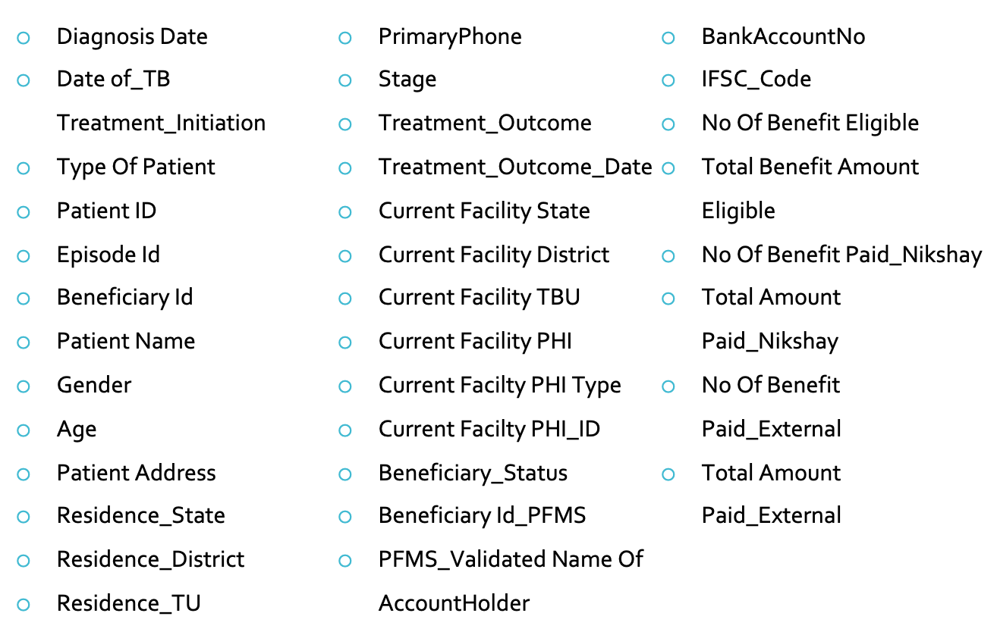
Beneficiary Register
Following Columns are populated in the Beneficiary Register:
Logic
Purpose

Slide 40
DBT Summary
Following Columns are populated in DBT Summary
State | State Name
District | District Name
TU | Tb Unit Name
Benefit Eligible | No. of Benefits created for a Particular beneficiary for the particular scheme. For e.g. [Notified TB Patients for scheme NPY (Nikshay Poshan Yojna)]
Paid Benefit | No. of Paid/credited Benefits in Beneficiary's A/C
Amount Payable | Total amount Paid/to be Paid for all Benefits
Amount Paid | Total amount Paid/credited for all Paid Benefits
Amount Removed | Total amount Rejected/Removed by Maker/Checker/Approver.
Logic
Purpose

Slide 41
DBT Beneficiary Status
Following Columns are populated in DBT Beneficiary Status
State | List of states
District | List of Districts for corresponding state
TU | List of Tuberculosis Units (TU) for corresponding district
Benefit Eligible | No. of Benefits created for a Particular beneficiary for the particular scheme. For e.g. (Notified TB Patients for scheme NPY)
Total Beneficiary | No. of beneficiaries for the particular scheme. for e.g. (Notified Patients for NPY)
Bank Details Empty for Beneficiary | No. of beneficiaries whose bank details are not entered in Nikshay
Bank Details Entered & sent to PFMS for Validation | No. of beneficiaries whose bank details are entered & sent to PFMS for validation
Bank Details Validated by PFMS | No. of beneficiaries whose bank details are validated by PFMS
Bank Details Rejected by PFMS | No. of beneficiaries whose bank details are Rejected by PFMS
Logic
Purpose

Slide 42
DBT Beneficiary Status
Following Columns are populated in DBT Beneficiary Status
State | List of states
District | List of Districts for corresponding state
TU | List of Tuberculosis Units (TU) for corresponding district
Benefit Eligible | No. of Benefits created for a Particular beneficiary for the particular scheme. For e.g. (Notified TB Patients for scheme NPY)
Total Beneficiary | No. of beneficiaries for the particular scheme. for e.g. (Notified Patients for NPY)
Bank Details Empty for Beneficiary | No. of beneficiaries whose bank details are not entered in Nikshay
Bank Details Entered & sent to PFMS for Validation | No. of beneficiaries whose bank details are entered & sent to PFMS for validation
Bank Details Validated by PFMS | No. of beneficiaries whose bank details are validated by PFMS
Bank Details Rejected by PFMS | No. of beneficiaries whose bank details are Rejected by PFMS
Logic
Purpose

Slide 43
DBT Benefit Status
Following Columns are populated in DBT Benefit Status
State | List of states
District | List of Districts for corresponding state
TU | List of Tuberculosis Units (TU) for corresponding district
Benefit Eligible | No. of Benefits created for a Particular beneficiary for the particular scheme. for e.g. (Notified TB Patients for scheme NPY)
Pending for PFMS Validation | No. of benefits pending due to Beneficiary Validation by PFMS (Empty, Entered & Sent for Validation)
Maker Pending for Validated Benefit | Maker/Checker(MO) to approve for payment (First level Approval)
Approver Pending Benefits | Approver(DTO) to approve for payment (Final Approval)
Approved (In PFMS Process) | Approved by DTO and sent to PFMS for payment
REMOVED by Maker/Approver | Rejected/Removed by Maker/Checker/Approver
DEFERRED by Maker/Approver | Deferred by Maker/Checker/Approver
ACCEPTED by PFMS | Accepted by PFMS and sent to bank for payment
REJECTED by PFMS | Rejected by PFMS
Paid Benefits | No. of paid benefits by Bank.
Logic
Purpose

Slide 44
DBT NPY
Following Columns are populated in DBT NPY
State | State Name
District | District Name
TBU | TBU Name
Total Notified | Total Notified Name
Bank Details Available | No. of beneficiaries whose bank details are entered & sent to PFMS for validation
Bank Details Validated | No. of beneficiaries whose bank details are validated by PFMS
(%) Bank Details Validated | Percentage of beneficiaries whose bank details are validated by PFMS
₹ Payable Amount | Total amount eligible for all the Benefits
Paid Beneficiary (Ni-kshay) | No. of Beneficiary Paid/credited atleast one Benefit in Beneficiary's A/C through Nikshay
₹ Paid Amount (Ni-kshay) | Total amount Paid/credited through Nikshay
Paid Beneficiary (External) | No. of Beneficiary Paid/credited Benefit through External Mode
₹ Paid Amount (External) | Total amount Paid/credited through External Mode
Logic
Purpose

Slide 45
DBT Transactional Summary
Following Columns are populated in DBT Transactional Summary
State | State Name
District | District Name
TU | Tb Unit Name
Total beneficiary | No. of Beneficiary Paid on selected Period which is Transaction date of benefit
Total Benefits | No. of Paid/credited Benefits in Beneficiary's A/C
Amount Paid | Total amount Paid/credited for all Paid Benefits
Logic
Purpose

Slide 46
DBT Risk Assessment
Following Columns are populated in DBT Risk Assessment
State | State Name
District | District Name
TB Unit | TBU Name
A/C Holder Name | Name of A/C holder
A/C Number | A/C Number of Beneficiary
Amount Credited through Corresponding facility | Amount Credited through Corresponding facility
No. Of Patients linked with the Account | No. Of Patients linked with the Account
Total Amount Credited across the Country | Total Amount Credited across the Country
TbuID | TB Unit ID
BankName | Bank Name
Logic
Purpose

Slide 47
THANK YOU

